Slide 1
Word Meaning and Structure

Slide 2
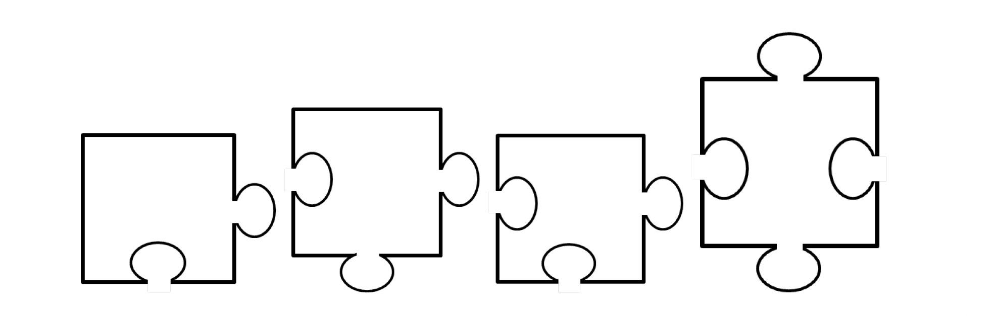
Prefix
Root
Suffix
WORD

Slide 3
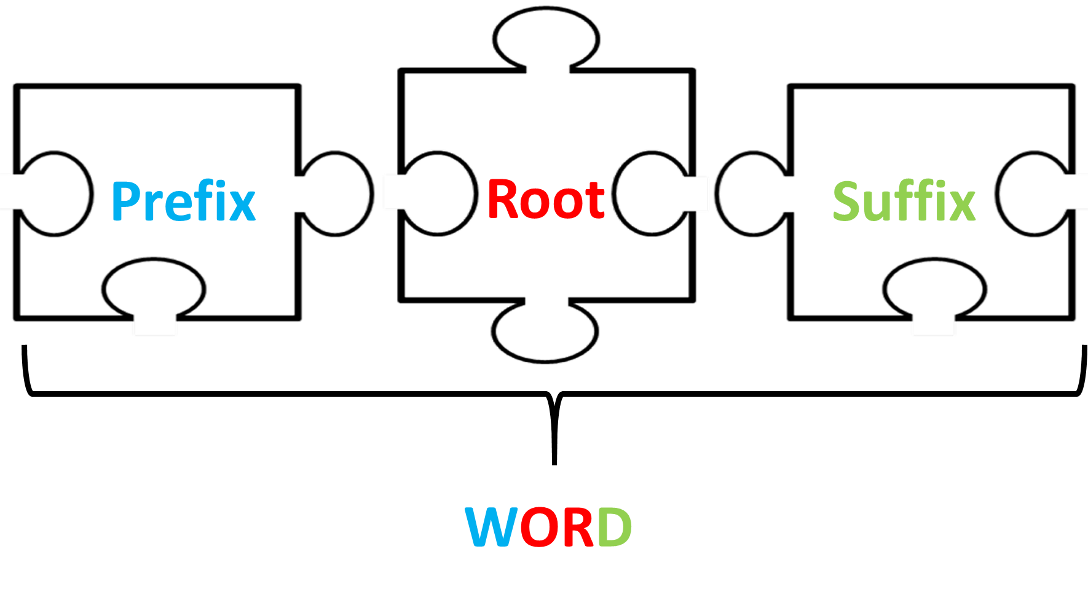
Prefix – something that can be added onto the beginning of a word to change its meaning in a specific way
Suffix – something that can be added onto the end of a word to change its meaning in a specific way
Root word – the result of striping out all the prefixes and suffixes of a word.

